Slide 1
Lists，Tables, Lattices, and Trees
Ben Koo
benkoo@tsinghua.edu.cn
May 12th，2020
Notes:
今天的主题是“区块链启发的新产业范式”

Slide 2
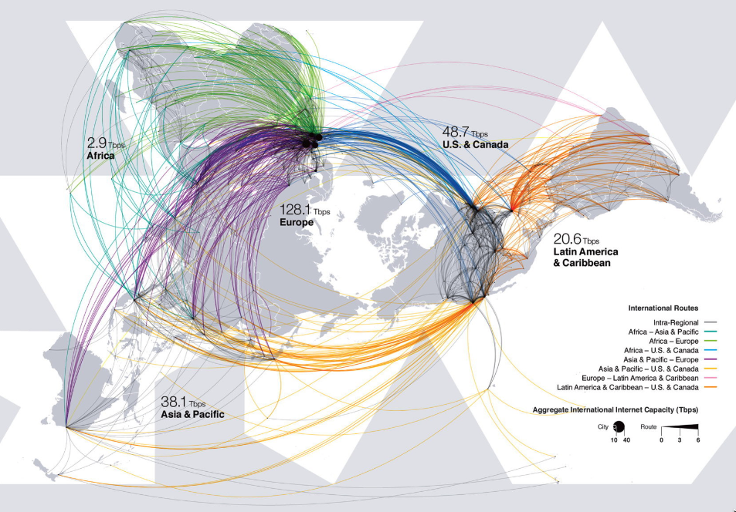

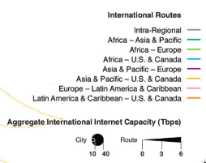
A Scale Free, Boundaryless Cyberspace

Slide 3
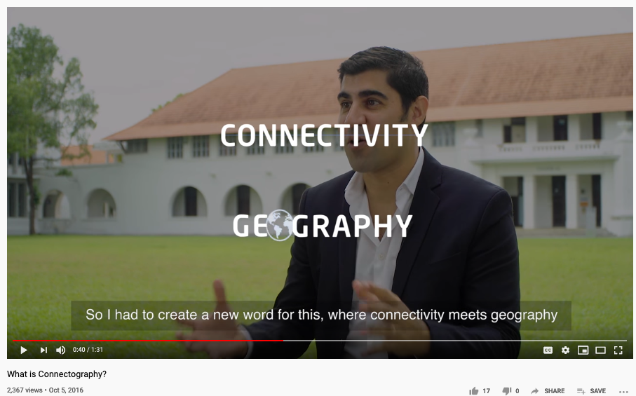
A 2016 Video on the “Future”

Slide 4
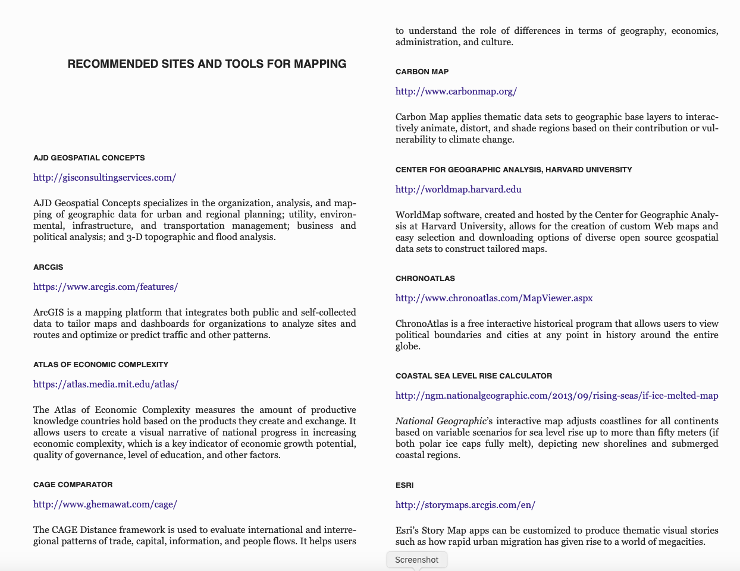
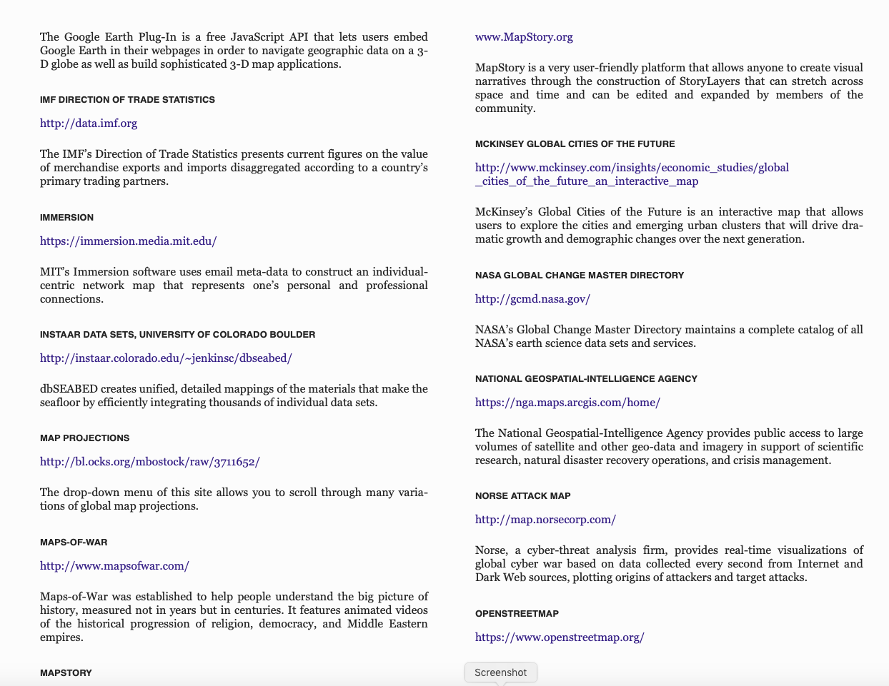
Some references to Mapping Tools
From the Appendix of Connectography

Slide 5
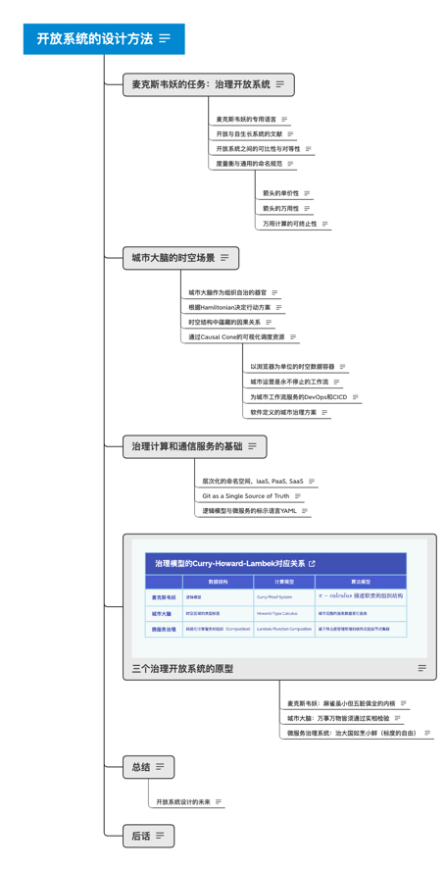
Multi-Lateral in Multi-Scale Context
TRADING UP: ECONOMIC PERSPECTIVES ON DEVELOPMNET ISSUES IN THE MULTILATERAL TRADING SYSTEM – ISBN-92-64-02559-6 © OECD 2006

Slide 6
Environmental Policy Governance
Interlinkages and the effectiveness of multilateral environmental agreements, by W. Bradnee Chambers

Slide 7


Slide 8
Image from P. XX (Introduction) of SuperCycle

Slide 9
The Elusive Science?
Image from P. 19 (Introduction) of SuperCycle

Slide 10
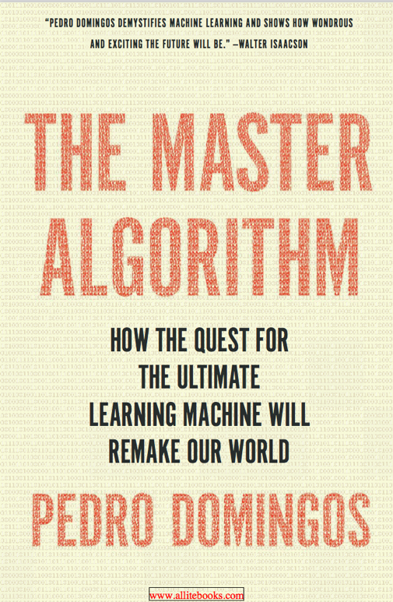
The Master Algorithm?
The central hypothesis:
All Knowledge – past, present, and future can be derived from data by a single universal learning algorithm
Pedro Domingos, TMA, P. 25
中译本

Slide 11
The Master Equation?

Slide 12
Production Rules =>

Slide 13
CFG Production Rules
http://www.diva-portal.se/smash/get/diva2:934721/FULLTEXT01.pdf

Slide 14
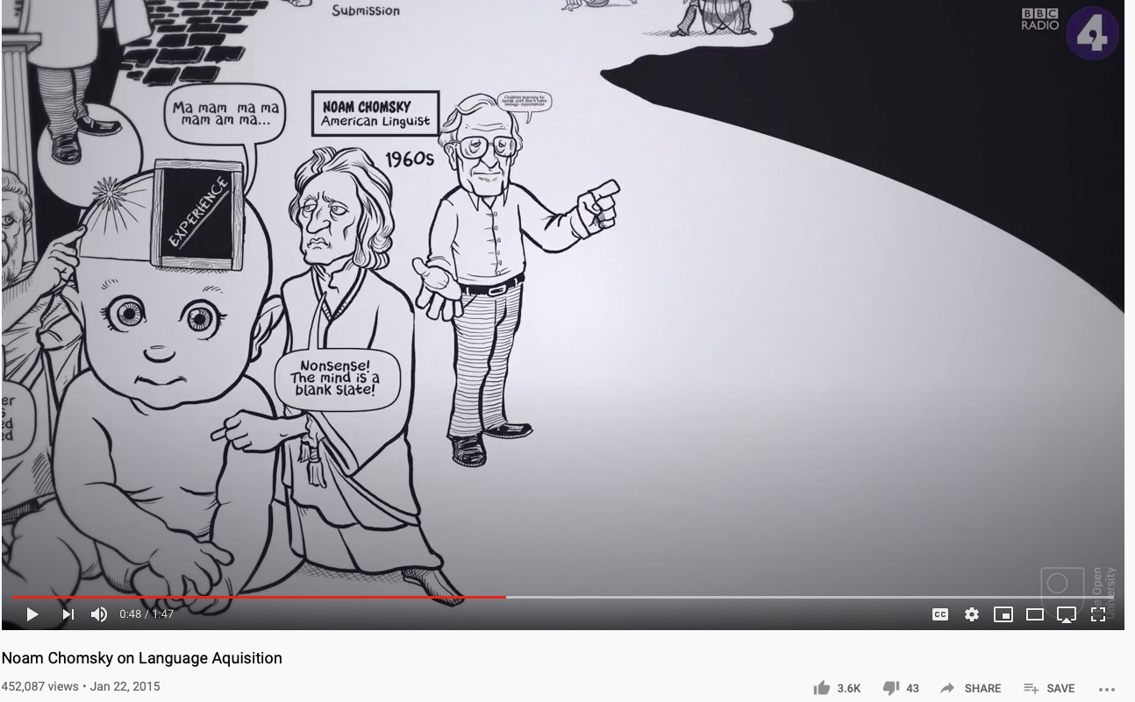
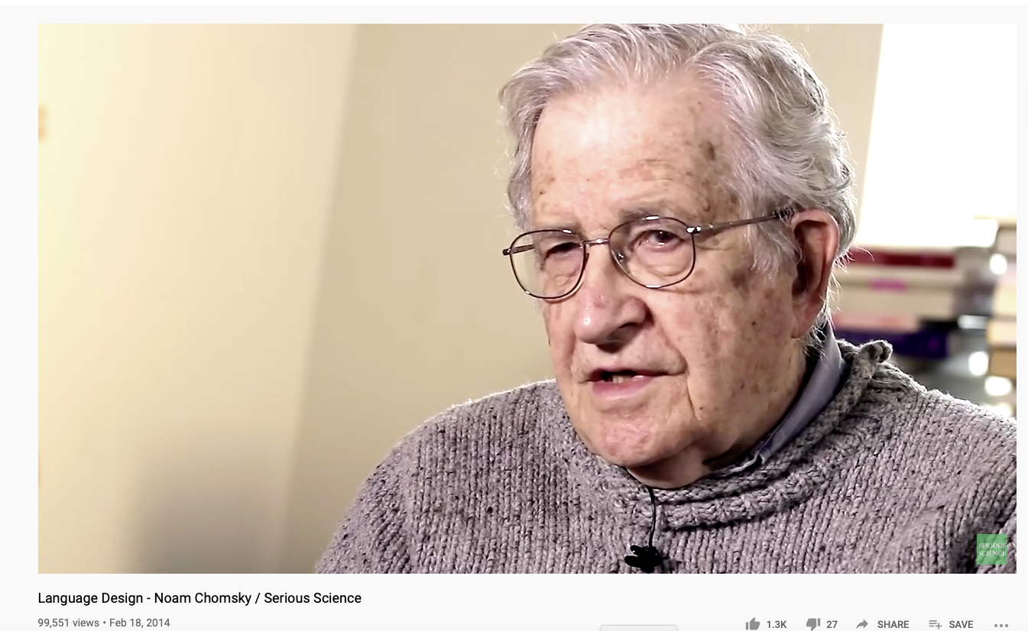
Chomsky’s Universal Grammar
Also see: Are you smarter than a Chimp?
https://youtu.be/7Cgpfw4z8cw?t=48
Language Design - Noam Chomsky / Serious Science

Slide 15
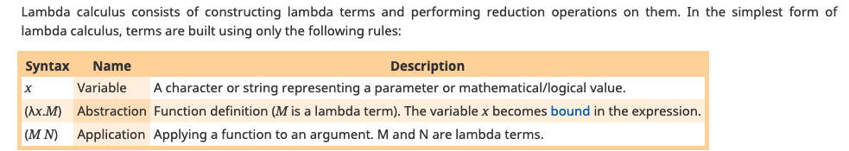

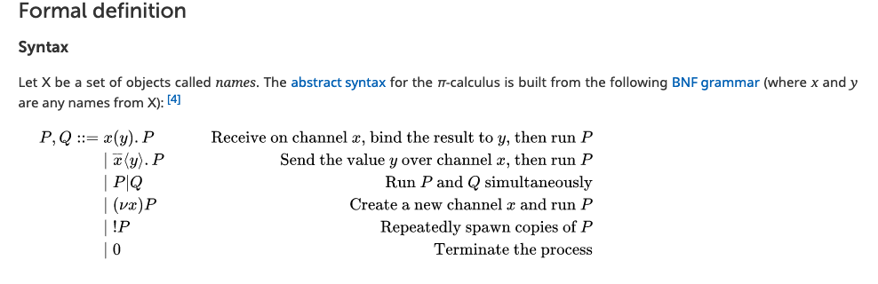
Lambda and Pi-Calculus

Slide 16
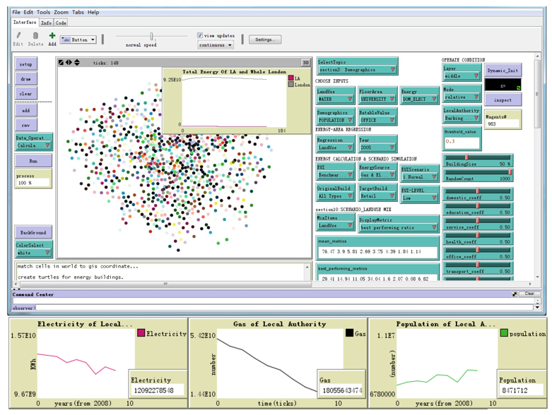
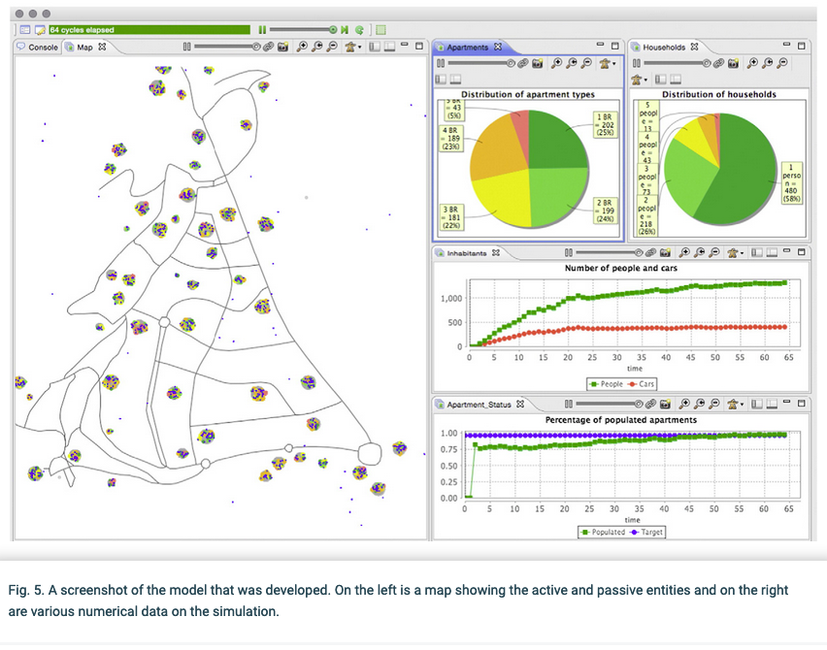
Looking at Communicating Agents
https://www.mdpi.com/2071-1050/10/11/4235/htm
https://www.semanticscholar.org/paper/Visualizing-the-workings-of-agent-based-models%3A-as-Hall-Virrantaus/2a618fd9dfcb1ab62b4b6e6ed4bae96b7e225161

Slide 17
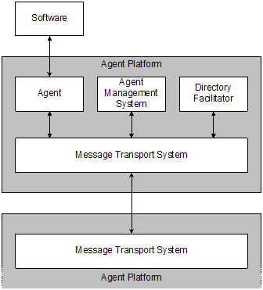
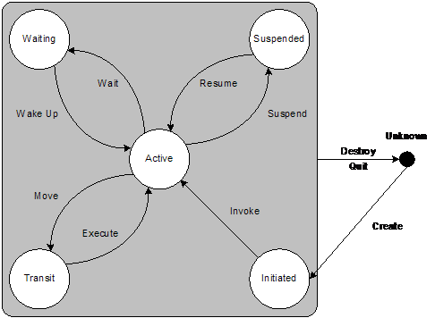
FIPA: Foundation of Intelligent Physical Agents
http://www.fipa.org/specs/fipa00023/SC00023J.html

Slide 18
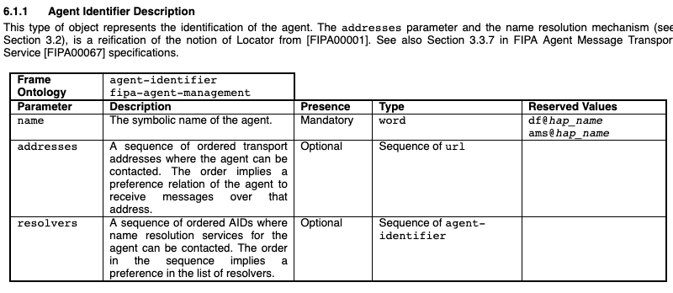
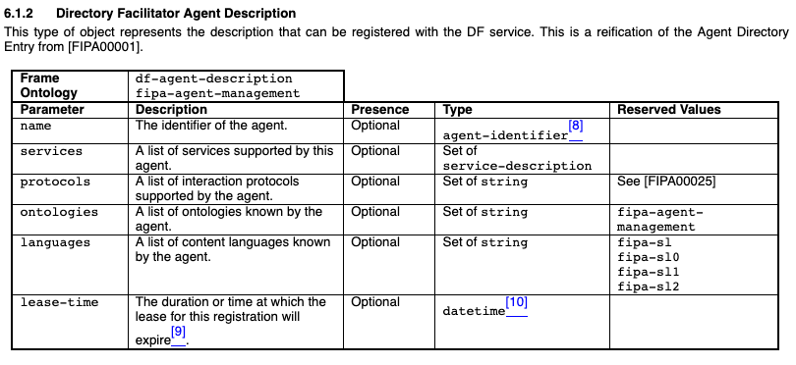
FIPA: Agent Specifications
http://www.fipa.org/specs/fipa00023/SC00023J.html

Slide 19
Knowledge Containers Classification
Content Type | Workflow Unit | Supporting Tools
Text (文本） | Individual Activity | SaaS
Directory (文件夹） | Collaboration Efforts | PaaS
Micro Service (微服务） | Computational Service | PaaS
Configuration and Deployment (监控) | Development & Operations (DevOps) | IaaS
Physical Environment (物理环境） | Context Specific Services | IaaS

Slide 20
三层认知体系
时空尺度 | 知识内容 | 实践能力
宏观 | 大环境与产业观察与分析 | 确认业务方向、经营目标、市场定位的能力
中观 | 资源的分类与排列组合 | 了解基础建设、市场机会、科技成熟度、人才供给、原料供应链等配置与优化的能力
微观 | 掌握特定应用场景与运营方式 | 根据产品或服务的特征，具备专业领域的相对竞争力

Slide 21
在可信计算基础上的通证经济
无界
法界
功能 | 现有工具 | 下一代科技手段
网络协作 | 微信支付、支付宝 | 区块链、智能合约(DApp)
可确权的数字资产 | 二维码、微信群人力确认 | 物本朔源、计算容器私有化
可计算的商业情报 | 微信机器人、小程序、 微商平台 | 商情的搜寻与推断

Slide 22
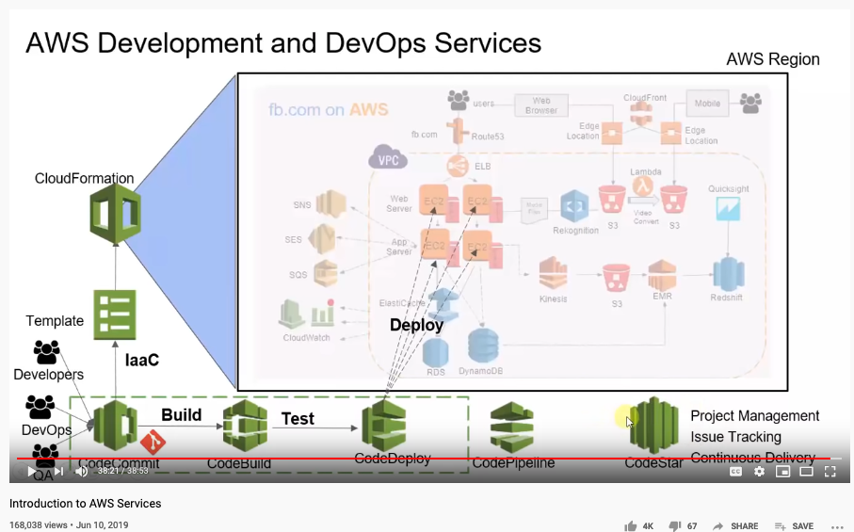
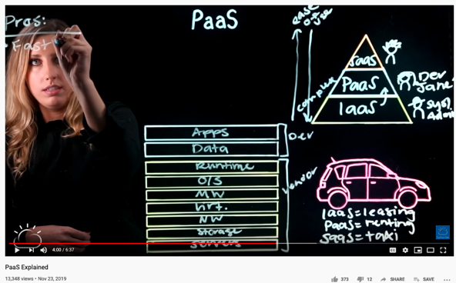
A Brand New World
https://youtu.be/Z3SYDTMP3ME?t=2301

